Slide 1
Welcome to The Boring Club
Notes:
Intros to officers. OFFICERS ARRIVE 15 MINS EARLY

Slide 2
Club Operation Basics

Slide 3
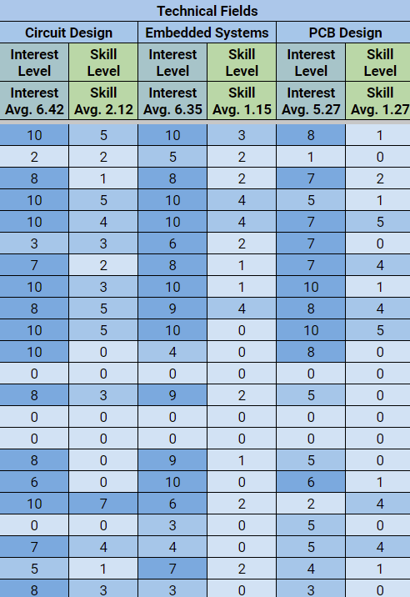
Spreadsheet
Interests
Fill out your row if you have not already
Place to quantify your skills and interests
Leads use this information to decide what projects to do
Notes:
Show example

Slide 4
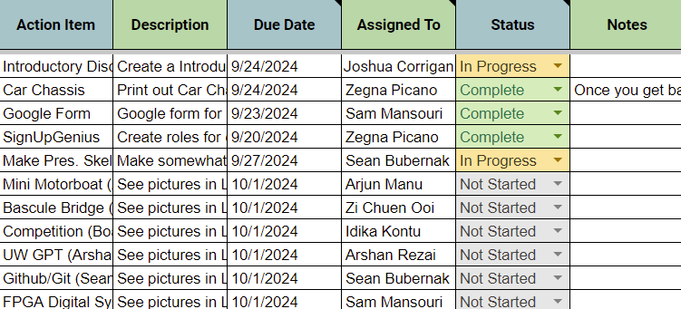
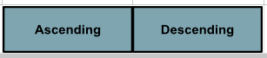
Spreadsheet
RAIL (Rolling Action Item List)
Anyone can assign tasks to anyone
Email is sent to assignee once name is entered
Sort by due date with ascending/descending buttons
Notes:
Show example

Slide 5
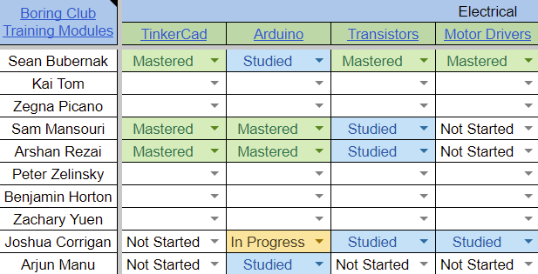
Spreadsheet
Training Modules
You do NOT have to be a lead to author a module
The training module does not have to be finished before it is linked, (WIP is fine)
This is for your benefit, what skills are you passionate about learning?
Notes:
Show example(s)

Slide 6
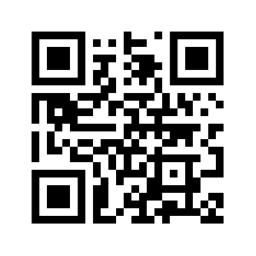
Discord
A place to interface with your team and see announcements
Bot will provide a introduction to the club and our resources
Please change your name in the channel to YOUR ACTUAL NAME
Notes:
Josh talk about Bot if finished?

Slide 7

Instagram
TBC related posts and stories
Meeting reminders
Other TBC events, (such as fundraisers)

Slide 8
Project Proposals

Slide 9
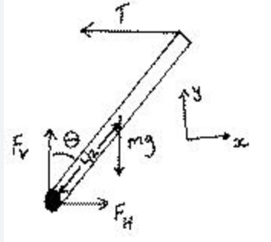
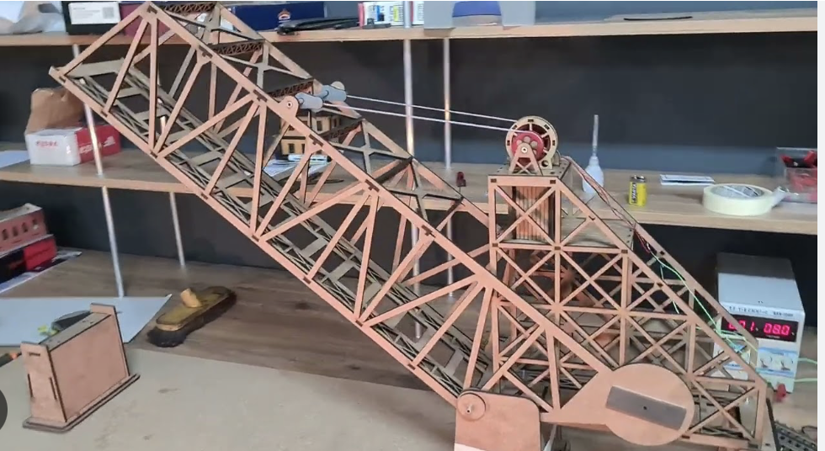
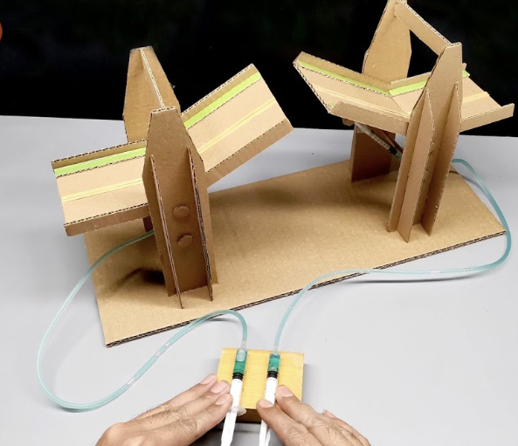
Bascule Bridge (Zi)
Statics, Physics 121
Different ways to design
Work with people different from your fields
Size and details of the project

Slide 10
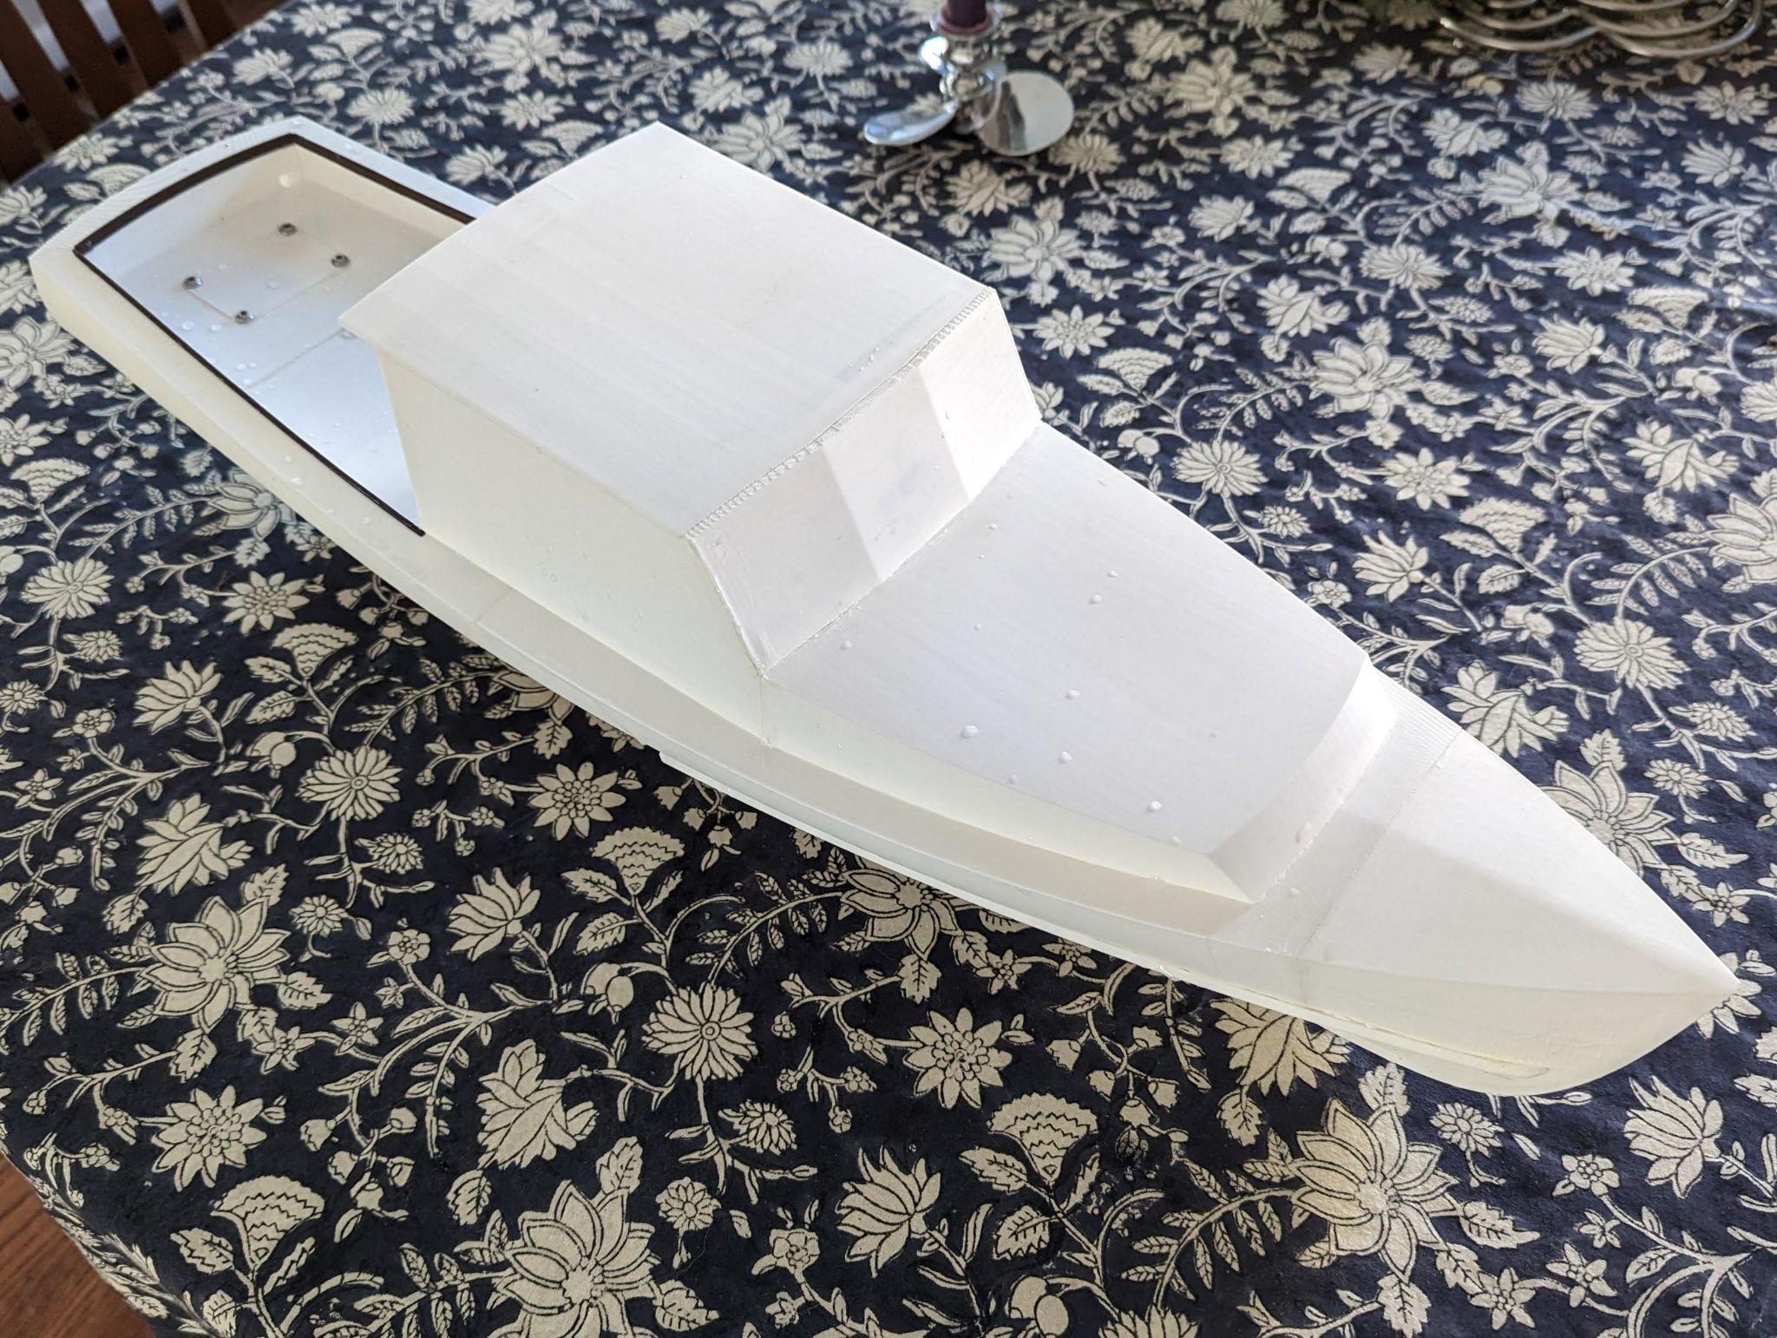
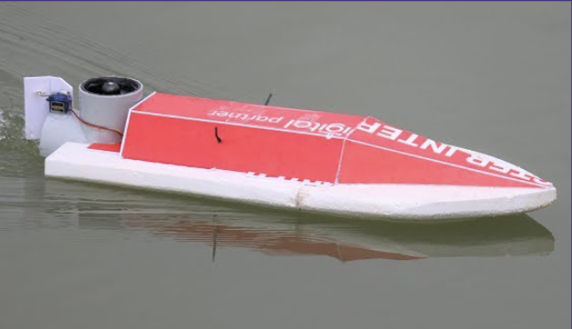
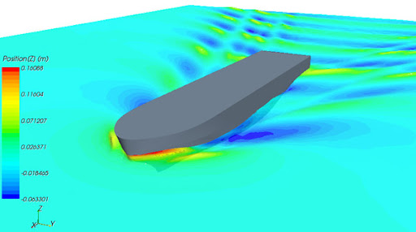
Mini Motorboat (Arjun)
Areas of focus : ECE, MechE, AeroE
Learn & develop skills: Arduino, 3D CAD, CFD modeling, C/C++, Circuit design
Later integrate alternate power sources

Slide 11

Competition (Boat v. Bridge) (Idika)
DUE WEEK 3!
Depending on which appeals to you
split up into groups and develop a project proposal!
Timeline, sub-groups, resources

Slide 12
UW GPT (Arshan)
UW version of Chat GPT which will essentially help answer all questions about UW
Helps develop software skills
Ties in with CS courses (CSE 12X, CSE 373)

Slide 13

Github/Git (Sean)
Platform for collaboration on coding and engineering projects
Version control and showcasing work
Build valuable skills you WILL use in the future
Only need 2-3 members for this project

Slide 14
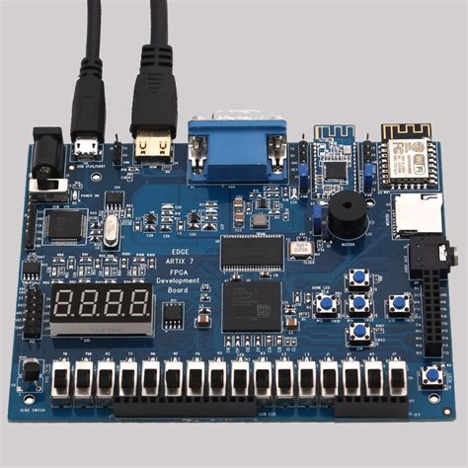
FPGA Digital System Sim (Sam)
Learn how to use digital logic (binary) to control a system
Program and simulate an FPGA chip
Create a system of your choice
E.g. traffic light, telephone operator, video game
Ties in with E E 271

Slide 15
Closing Remarks
Meetings are weekly on Wednesday, here in SAV 169, 7-8 pm, (though we have the room until 9)
Please fill out your row in the spreadsheet
Questions? Thanks for coming!

